Slide 1
Confusing CBC Birds
(Potentially)

Slide 2
Which Titmouse?
Black-crested Titmouse
Tufted Titmouse

Slide 3
Hybrid

Slide 4
Yellowlegs
Lesser Yellowlegs
Greater Yellowlegs

Slide 5
Direct Comparison

Slide 6
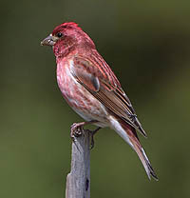
Finches
House Finch
Purple Finch

Slide 7
?

Slide 8
Accipeters
Cooper’s Hawk
Sharp-shinned Hawk

Slide 9
Wrens
Winter Wren
House Wren

Slide 10
Woodpeckers
Downy Woodpecker
Hairy Woodpecker

Slide 11
Direct Comparison

Slide 12
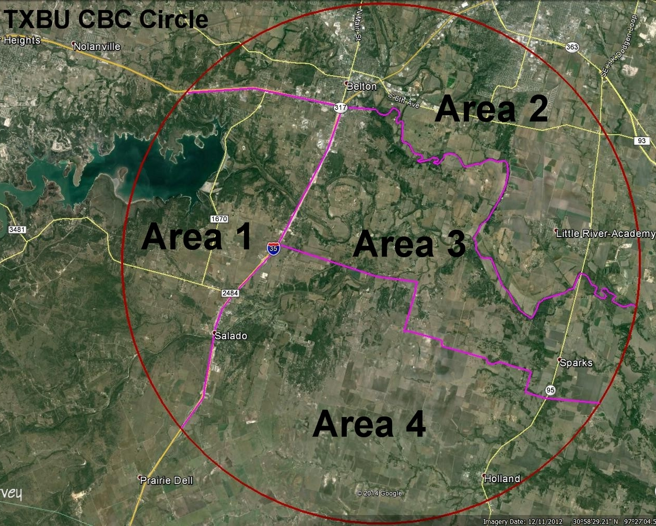

Slide 13
Area 1

Slide 14
Area 2

Slide 15
Area 3

Slide 16
Area 4

Slide 17
CBC Leaders
Quad | Leader | Phone | Meeting | Time
1. NW | Gil Eckrich | 254 534 0061 | Chalk Ridge Falls | 0800
2. NE | David Cimprich | 937-733-0168 | Belton McDonalds | 0800
3. SE | Tom Robbins | 254-295-6623 | Belton Park & Ride | 0730
4. SW | Randy Pinkston | 254-718-9910 | Salado Brookshire Bros | 0730

